Slide 1
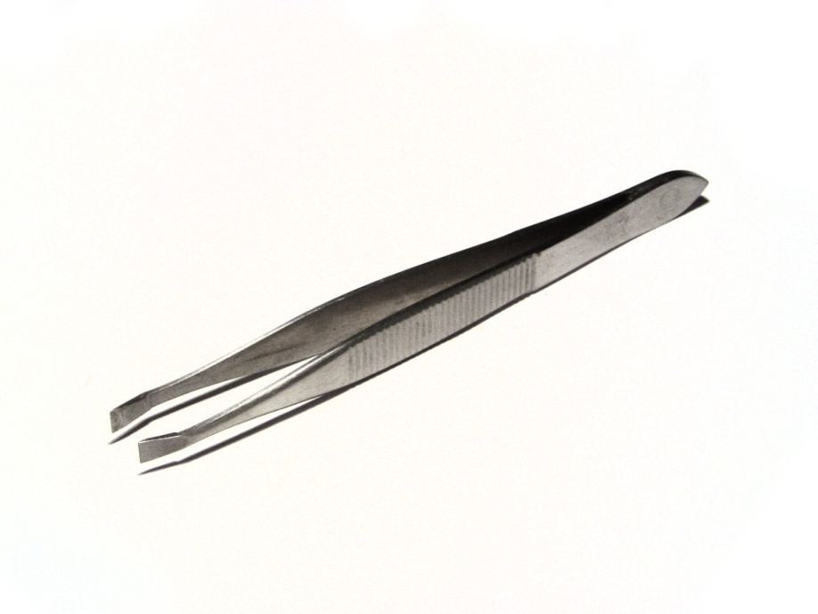
Daily Review
Identifying Levers
Draw the following lever on your whiteboard and label the fulcrum, input force and output force.
What class of lever is this? Explain your choice.
The tweezers are a class ______ lever because the _______ is positioned in the middle, between the ______ and the _______.
Reminder
FOIL! Class 1: Fulcrum in the middle Class 2: Output force in the middle Class 3: Input force in the middle Levers are easy!

Slide 2
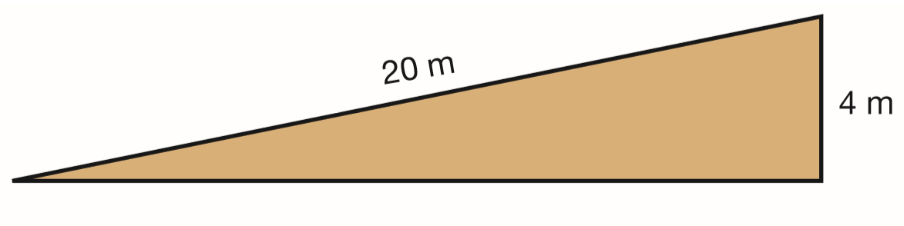
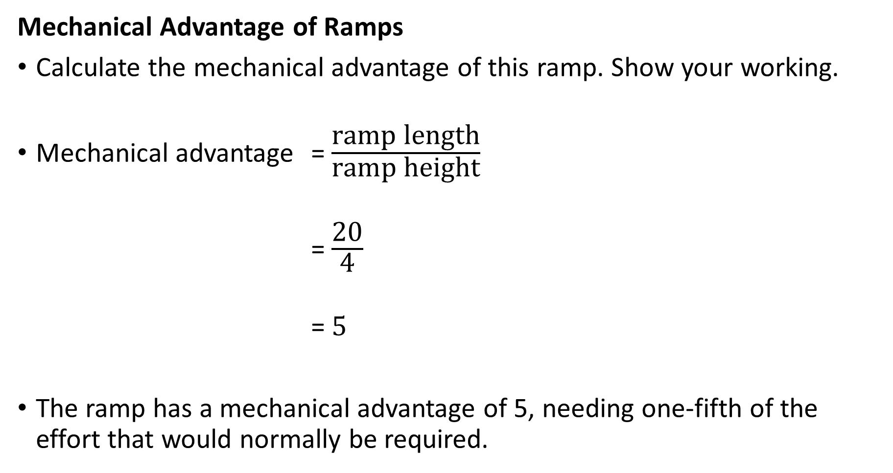
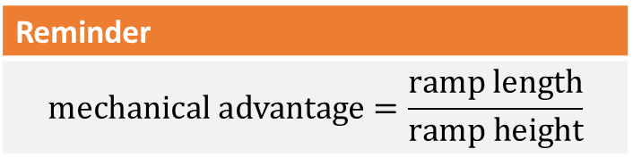
Daily Review
Reminder
$$\text{mechanical} \text{advantage}=\frac{\text{ramp} \text{length}}{\text{ramp} \text{height}}$$
Mechanical Advantage of Ramps
Calculate the mechanical advantage of this ramp. Show your working.
Mechanical advantage = $\frac{\text{ramp} \text{length}}{\text{ramp} \text{height}}$
= $\frac{\text{20}}{\text{4}}$
= 5
The ramp has a mechanical advantage of 5, needing one-fifth of the effort that would normally be required.

Slide 3
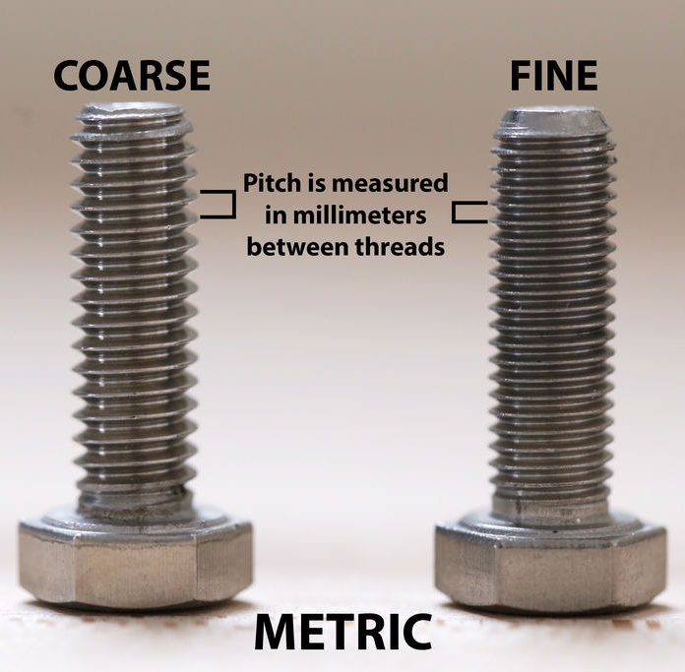
Daily Review
Which bolt will require less effort to use? Explain your choice using a full sentence.
Comparing Screws (and Bolts)
closer thread = smaller pitch = less input force required
The bolt on the right will require less input force because its thread is closer or because its pitch is smaller (so the force acts over a larger distance).

Slide 4
Daily Review
Which wedge will require less effort to use? Explain your choice.
Comparing Wedges
steeper slope = sharper wedge = less input force required (The trade-off is that a narrow wedge moves things a smaller distance.)
The wedge on the left will require less input force because it has a steeper slope.

Slide 5
Simple Machines: Wheels and Axles Year 7 Science

Slide 6
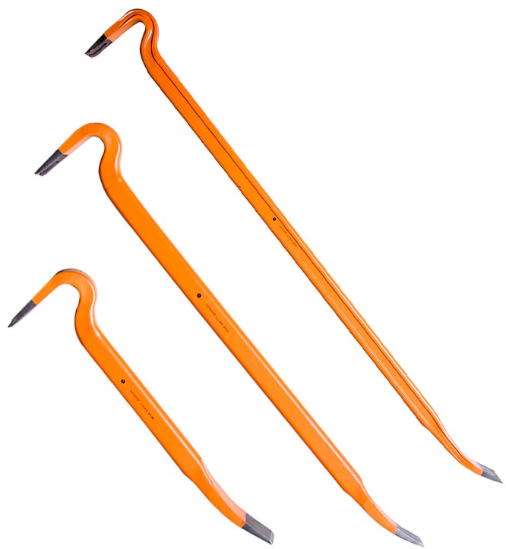
Learning Objectives
CFU
What are we going to learn?
Describe the use of wheels.
Identify and describe force and distance multipliers.
Activate Prior Knowledge
Levers can make tasks easier by requiring less effort over a larger distance.
Think, Pair, Share: What happens to force required to use a lever as the lever changes size?

Slide 7
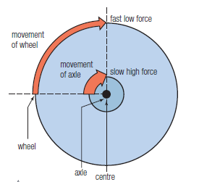
Concept Development
CFU 1
What is a wheel?
Wheels
A wheel is a special lever that turns in circles around an axle (the fulcrum).
Wheels can make tasks easier or faster.
They can produce either a force or a distance advantage.
CFU 2
What is the benefit of using a wheel?

Slide 8
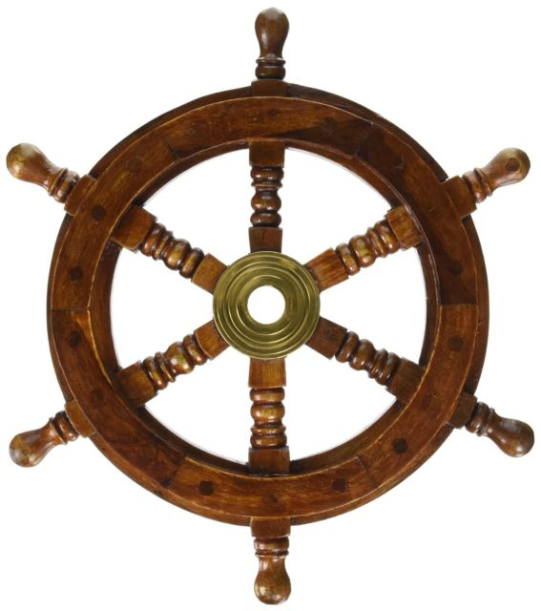
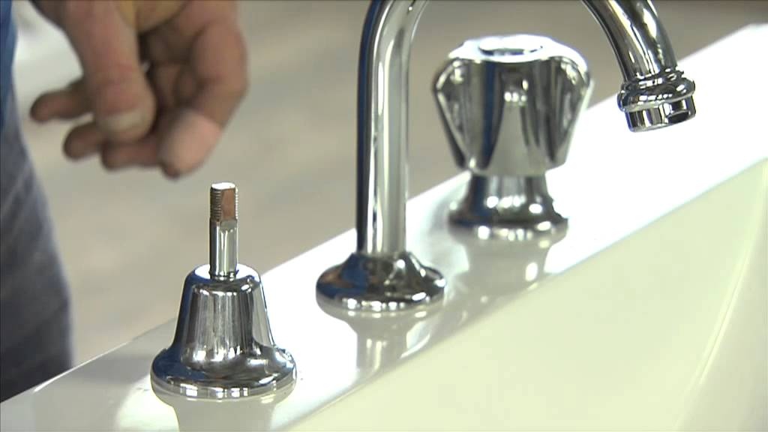
Concept Development
CFU 1
Where is the axle situated on a wheel?
Wheels and Axles
A wheel is a special lever that turns in circles around an axle.
The rim is the outside of a wheel.
A wheel on an axle is a special type of lever:
each spoke is a lever
the axle is the fulcrum
When you apply a force to turn on a tap, the handle acts as a wheel. It increases the force you apply at its centre, allowing the axle to turn.
CFU 2
Think, Pair, Share: Which part of a wheel turns faster: the axle or the rim?

Slide 9
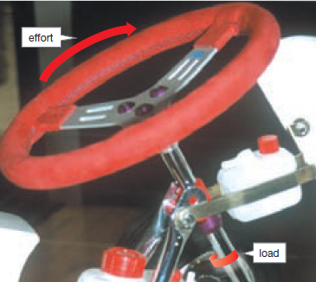
Concept Development
CFU 1
What does a force multiplier do?
Force Multipliers
Force multipliers turn a large movement with a small input force into a small movement with a large output force.
The input force applied to the rim of the steering wheel is multiplied at the axle.
The larger the steering wheel, the easier it is to turn the axle.
CFU 2
Think, Pair, Share: List two other examples of a force multiplier.
input force
output force

Slide 10
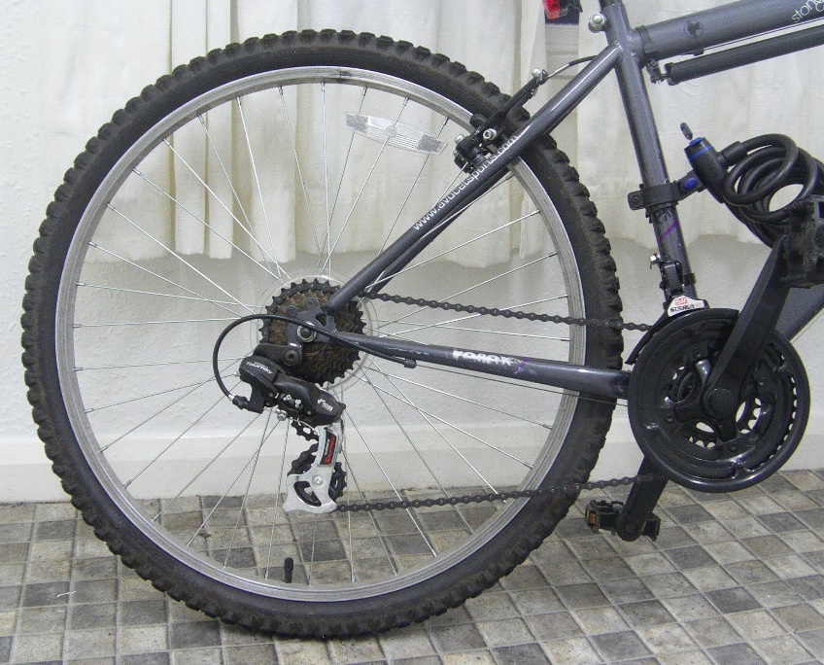
Concept Development
CFU 1
What does a distance multiplier do?
Distance Multipliers
Distance multipliers turn a small movement with a large input force into a large movement with a small output force.
A bike moves because the chain applies an input force to the wheel. This causes the wheel to travel a further distance than the chain.
CFU 2
Think, Pair, Share: Where else have you seen a distance multiplier?
output force
input force

Slide 11
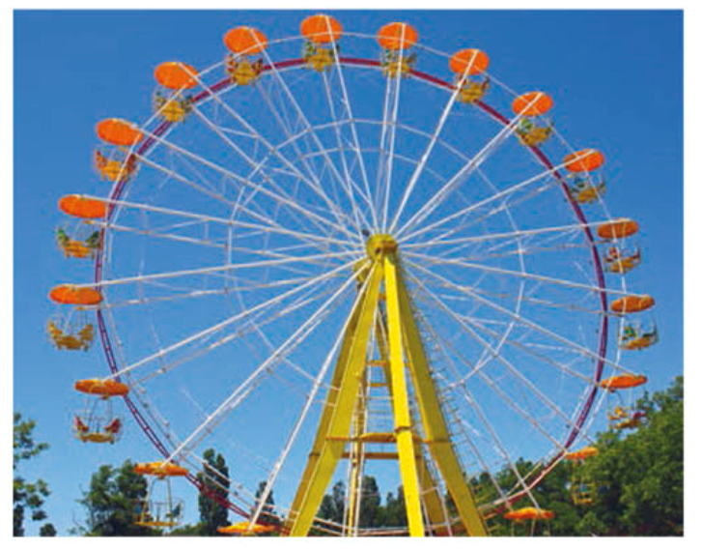
Skill Development / Guided Practice
output force
CFU 1
Where is the input force on the Ferris wheel?
Is the Ferris wheel a force or distance multiplier? Explain your choice.
CFU 2
Where is the output force on the Ferris wheel?
The Ferris wheel is a distance multiplier because a small movement with a large force creates a larger movement with a small force.
CFU 3
Which movement is bigger?
input force
CFU 4
Is the Ferris wheel a force or distance multiplier?
Reminder
Force multipliers: large movement, small input force → small movement, large output force Distance multipliers: small movement, large input force → large movement, small output force

Slide 12
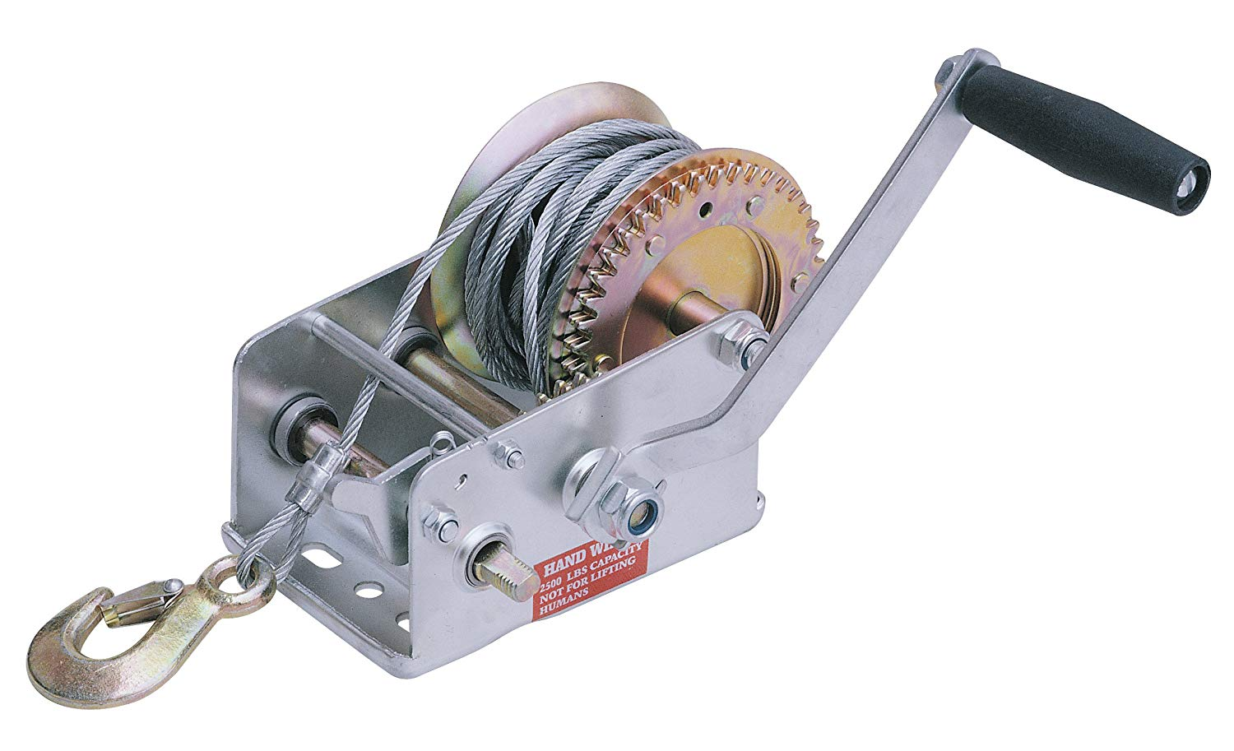
Skill Development / Guided Practice
CFU 1
Where is the input force on the winch?
output force
Is the winch a force or distance multiplier? Explain your choice.
CFU 2
Where is the output force?
CFU 3
Which movement is bigger?
The winch is a force multiplier because a small input force creates a larger output force.
input force
CFU 4
Is the winch a force or distance multiplier?
Reminder
Force multipliers: large movement → small movement small input force → large output force Distance multipliers: small movement → large movement large input force → small output force

Slide 13
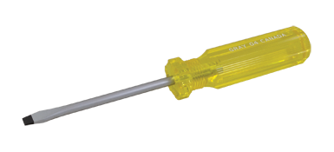
Skill Development / Guided Practice
CFU 1
Where is the input force on the screwdriver?
Is the screwdriver a force or distance multiplier? Explain your choice.
input force
CFU 2
Where is the output force?
output force
CFU 3
Which movement is bigger?
The screwdriver is a force multiplier because a small input force creates a larger output force.
CFU 4
Is the screwdriver a force or distance multiplier?
Reminder
Force multipliers: large movement → small movement small input force → large output force Distance multipliers: small movement → large movement large input force → small output force

Slide 14
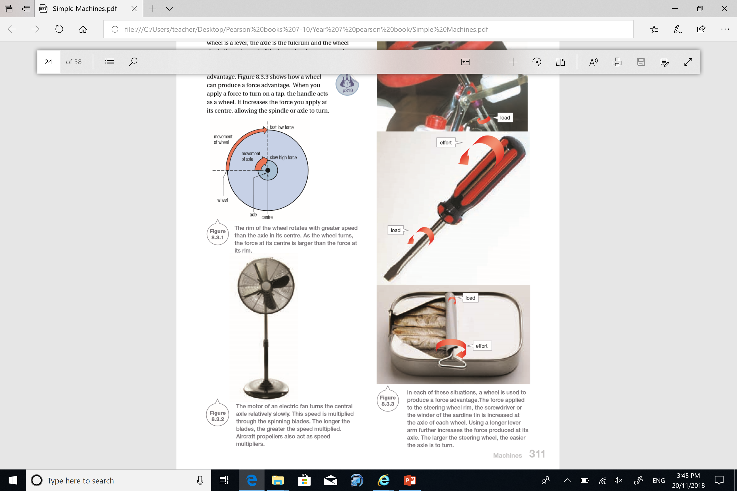
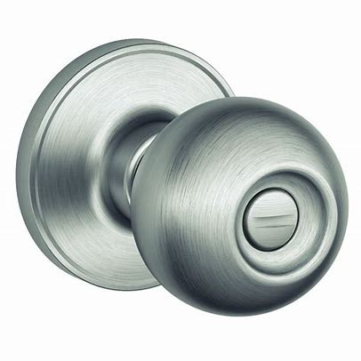
Relevance
As you’ve already seen, wheels are used a lot in everyday life.
Knowing how to multiply force or distance can help you understand how everyday machines and tools work.

Slide 15
Skill Closure
List three examples of wheels in your everyday life.
What is the difference between a force multiplier and a distance multiplier?
Is a circular doorknob a force multiplier or distance multiplier?

Slide 16
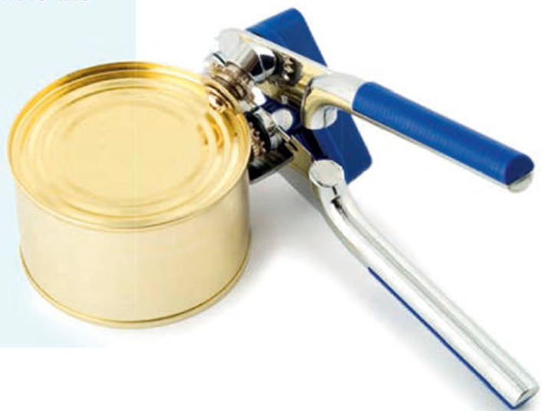
Independent Practice
Is the fan a force multiplier or a distance multiplier? Explain your answer.
Draw a wheel on a car, and label its rim and axle.
Is the can opener acting as a wheel and axle? Explain how it works.

